Slide 1
The Characterization of Shell Matrix Protein, KRMP-3
2120210064@smbu.edu.cn
Li Hao (2nd year graduate student) 2120210064@smbu.edu.cn
2023/03/18

Slide 2
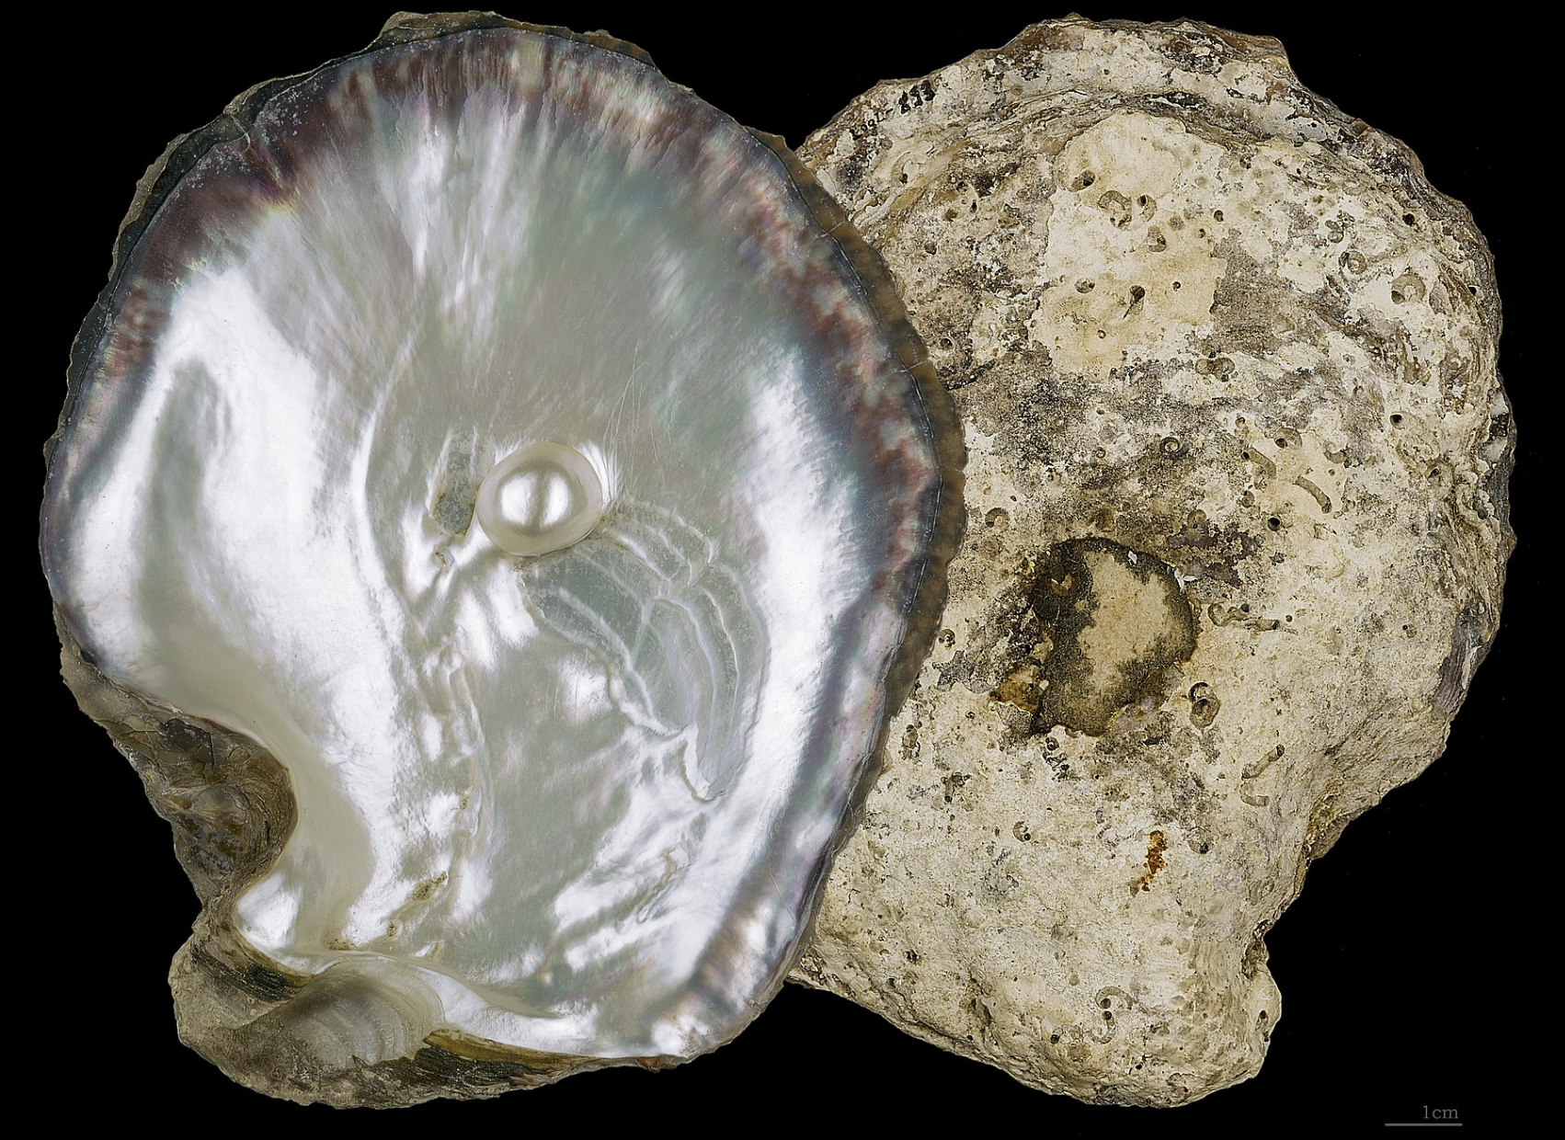
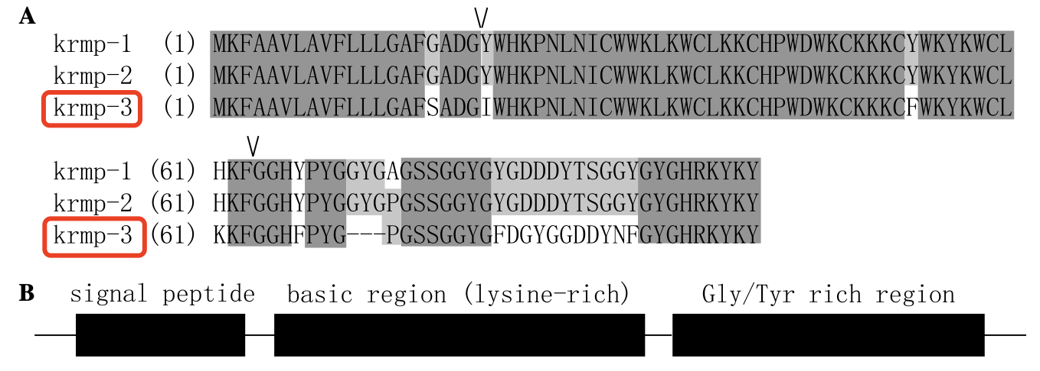
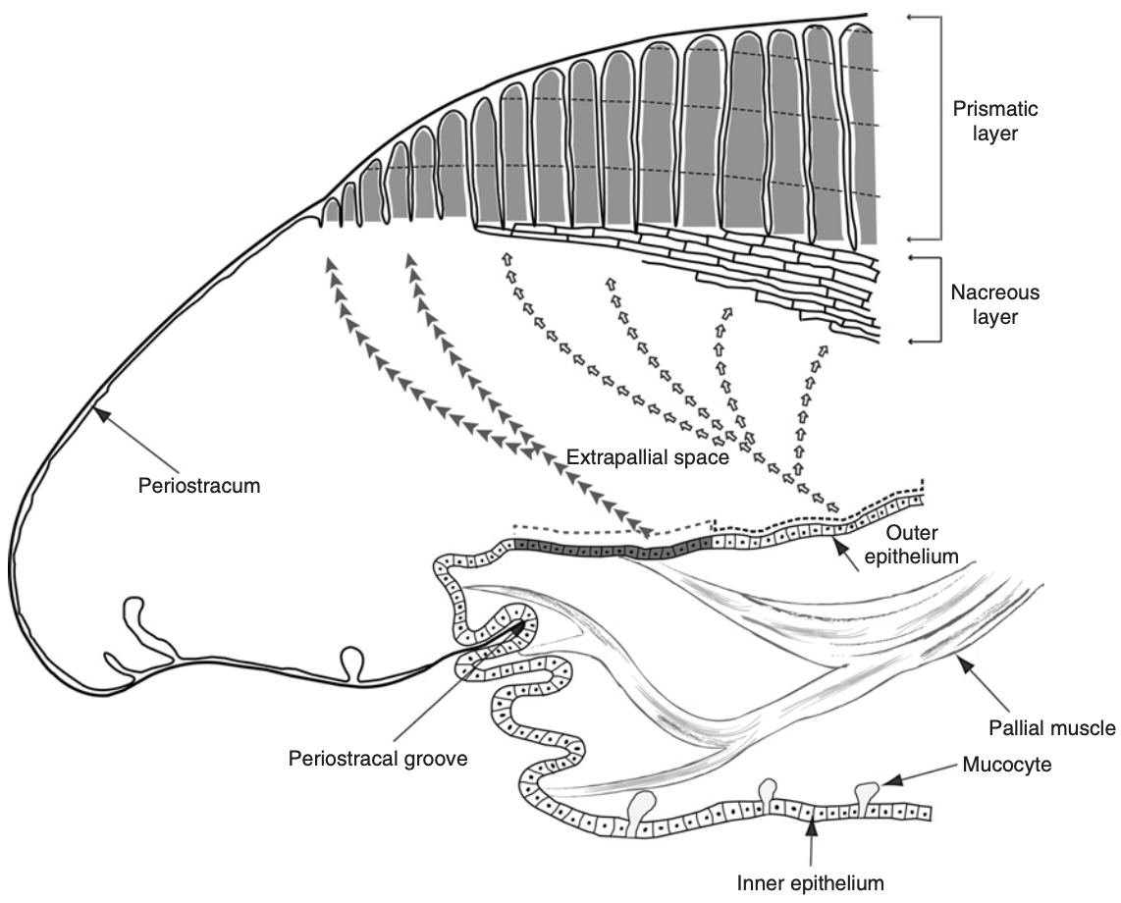
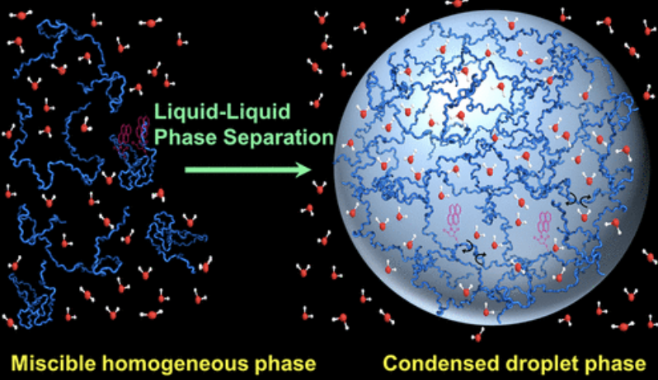
Current research
2120210064@smbu.edu.cn
The Characterization of Shell Matrix Protein, KRMP-3

Slide 3
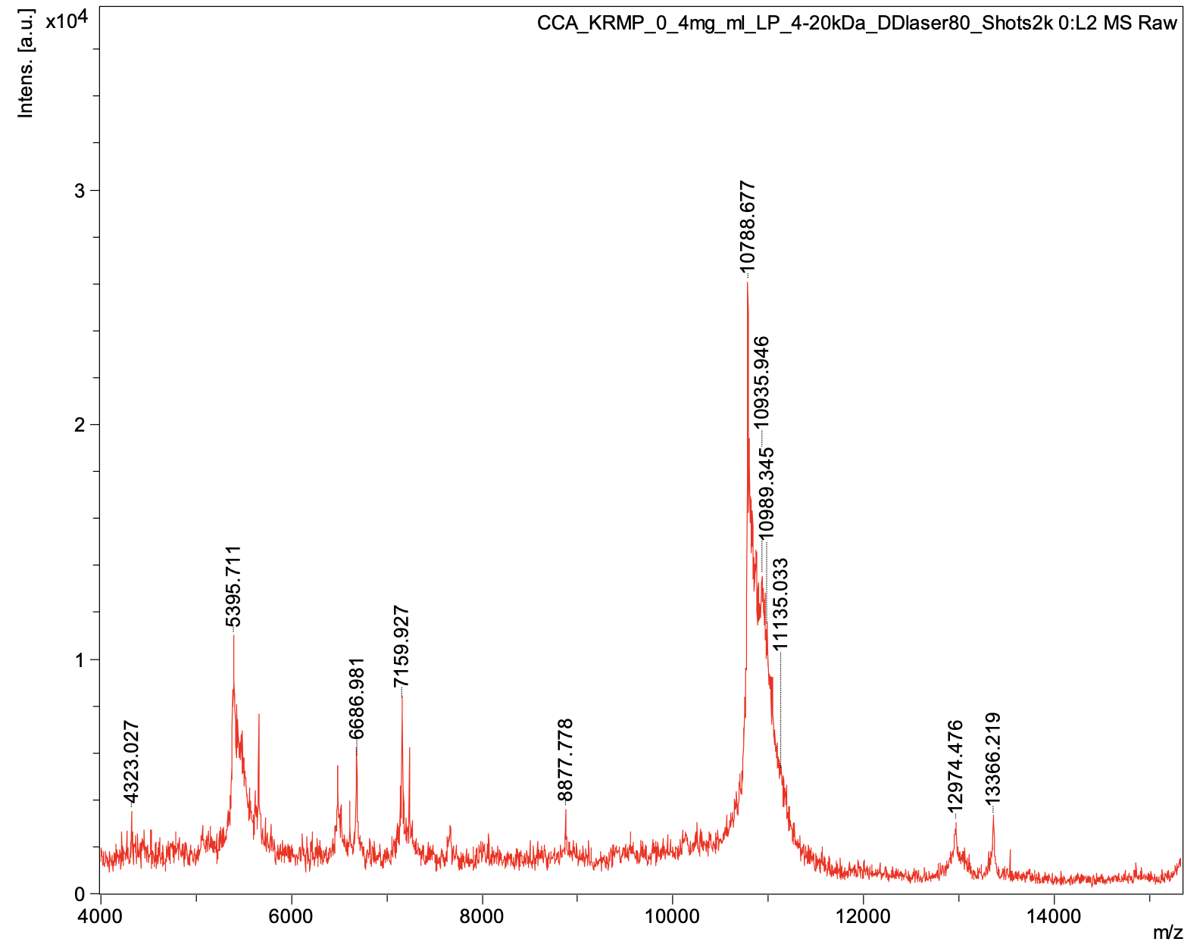
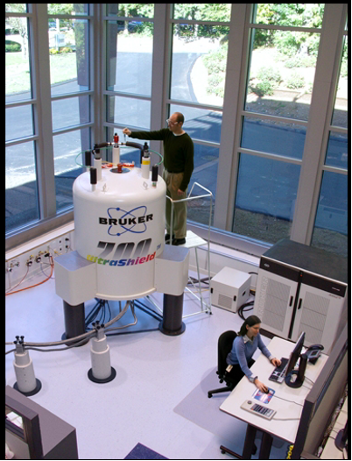
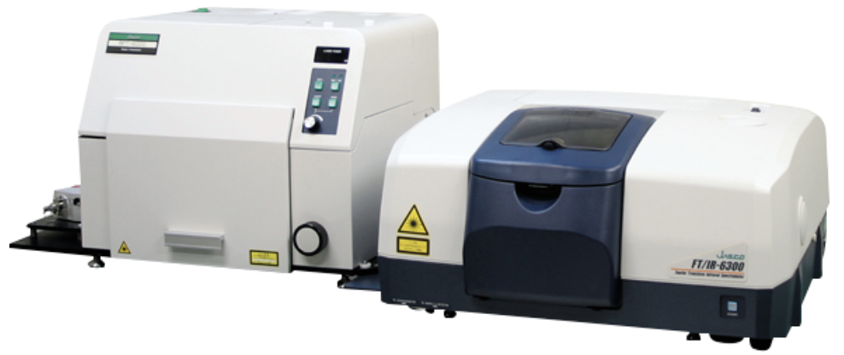
Current research
2120210064@smbu.edu.cn
The Characterization of Shell Matrix Protein, KRMP-3
 | Helix | Sheet | Turn | Other
KRMP-3 | 5.3% | 47.1% | 10.8% | 36.8%
17 kd
10 kd
SDS-gel
MS
CD
Confocal microscopy
Raman Spectrometer
SEM
NMR

